Slide 1


New England Board of Higher Education
Legislative Advisory Committee Meeting
March 16, 2020
Theresa Rowland
Interim CEO/Vice President, Sector Strategies
Commonwealth Corporation
2 Oliver Street - 5th Floor
Boston, Massachusetts 02109
www.commcorp.org

Slide 2
Workforce Training Fund

Slide 3
History of the WTFP
The MA Workforce Training Fund Program (WTFP) est.1998
The mission of WTFP is to provide businesses with the training resources to invest in the Massachusetts workforce, improve employee skills, and maintain the economic strength and viability of the Commonwealth’s businesses.
The WTFP awards training grants to businesses to:
  Promote job growth, job retention, or increased wages
  Improve business productivity, competitiveness, and ability to do business in Massachusetts
FY 2019 the WTFP awarded $20+ million to over 600+ businesses to train 15,000+ workers

Slide 4
How is the WTFP Funded?
The WTFP is funded by Massachusetts employers via a surcharge on Unemployment Insurance (UI) payments.
$8.⁴⁰ per employee annual WTFP contribution
The trust collects $18-22M annually for incumbent worker training grants.
Commonwealth Corporation administers WTFP on behalf of the Executive Office of Labor and Workforce Development.

Slide 5
WTFP Programs
Express Program
  Small businesses (w/ 100 or fewer MA employees)
  50% reimbursement for ‘off the shelf’ training
Small Business Direct Access Program
  Small businesses (w/ 100 or fewer MA employees)
  Free training in list of pre-approved courses
General Program
Companies of any size
  Up to $250,000 for two-year, customized training plans

Slide 6
Common Topics
Process Improvement /Lean Training
Sales Training
Customer Service
Business/Technical writing
Management, and Supervisory Skills
Project Management
Quality Assurance (ISO 9001, AS 9100, etc.)
Software Training (Microsoft, Adobe etc.)
Training for Professional Certification:
  IPC Certification (Electronics, Circuit Boards, Wiring, etc.)
  Network Administration/Cyber Security
  Human Resources Management (SHRM)

Slide 7
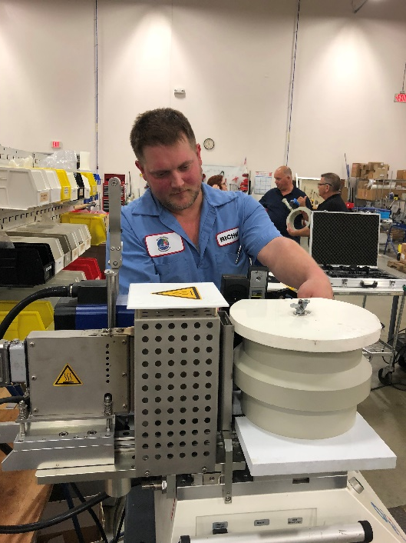
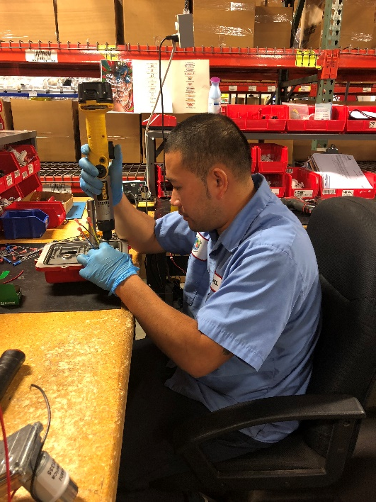
Asahi/America, based in Lawrence MA, provides thermoplastic fluid flow solutions for industrial, commercial and environmental applications. Their products are used in water treatment facilities, commercial laundromats and some of the world’s largest water parks and aquariums.

Slide 8
Challenge
Training Solution
Operations Management, Supervision and Management, Lean Manufacturing (Total Productive Maintenance, Problem Solving, Workplace organization) and Six Sigma to eliminate defects.
Outcomes
Added 10 new employees, and all trainees rec’d wage increases.
Asahi was entering new markets and needed to be responsive to customer demands.
The company’s aggressive five year growth plan highlighted the need to improve processes, and increase efficiencies in production.
Increased labor productivity rate (output) from 31% to 74%.
Invented a new pressure testing tool which reduced assembly time by 40%

Slide 9
“One of the most valuable things about this experience was that we got to hear the employees’ perspective. If we had told them how to do something, we would not have had the same success. Instead, this training gave our employees the tools to problem solve and the confidence to suggest new ways of doing things. Without the WTFP grant, this would not have been possible.
--Steve Marchant, Manufacturing Manager

Slide 10
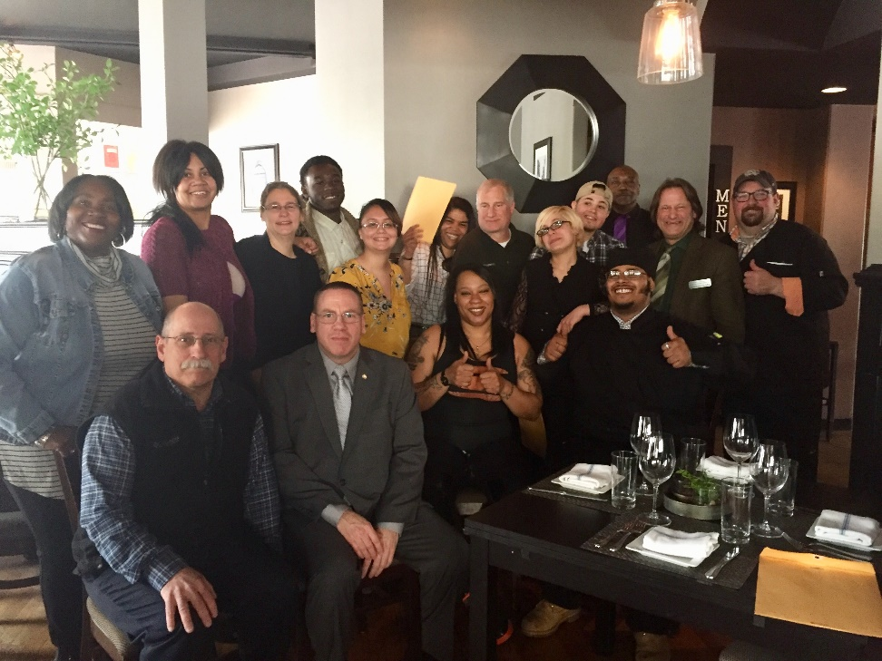
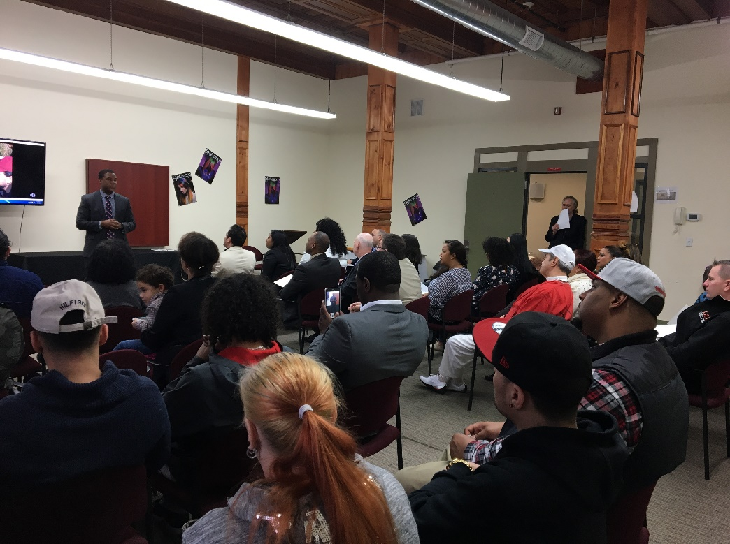
Workforce Competitiveness Trust Fund

Slide 11
4 Features of Sector Programs
Industry driven: significant business engagement in program design (and often delivery) and placement/advancement
Recruitment and screening processes, technical, work readiness and academic skills development all contextualized to target industry and occupation(s)
Continuum of services, which might include preparation for and placement in initial position with support to prepare for and move to higher skill position(s)
Career coaching, case management and other resources designed to support program success and employment retention and advancement

Slide 12
Sector Strategies in MA began in late 1990’s
Welfare to Work (Boston)
1997
Extended Care Career Ladder Initiative (CommCorp)
(Created by Legislature in 2000)
Early experimentation with blended funding (CommCorp)
(2002-2006)
Workforce Competitiveness Trust Fund (CommCorp) (Created by Legislature in 2006)

Slide 13
Workforce Competitiveness Trust Fund
Created in 2006 Economic Development bill
Purpose is twofold:
  Support the development & implementation of employer and worker responsive programs to enhance worker skills, incomes, productivity & retention and to increase the quality & competitiveness of MA firms
Requires partnerships with two or more employers with similar workforce needs
Allows for incumbent worker & pipeline training
Provides funding for up to $500,000 and up to 3 years
30% match

Slide 14
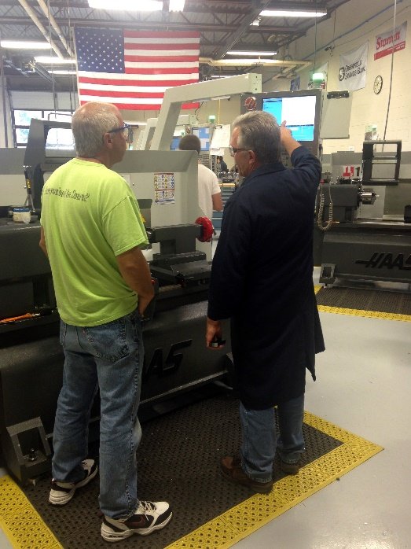
Workforce Competitiveness Trust Fund
$38.5M appropriated since 2006
2006: $18M in Economic Development Bill
2012: $5M in Economic Development Bill
FY16: First year in state budget $2M
FY17: $500K
FY18: $1M
FY19: $5M
FY20: $7M

Slide 15
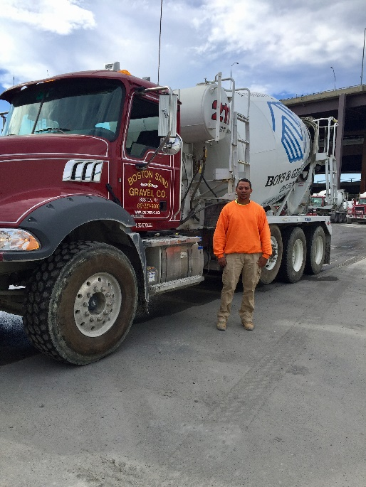

Workforce Competitiveness Trust Fund
Awarded grants to more than 85 partnerships
Many partnerships have sustained/evolved
Trained more than 8,000 individuals
74% placement rate

Slide 16
THANK YOU
Theresa Rowland
www.commcorp.org
trowland@commcorp.org

